Slide 1
DATAVIZ 300 Week 7: Enabling Organizations with Data
Notes:
In video 1, three members of the CCBC business intelligence team talk about how getting out of the “report factory” mode has freed them to provide true analysis. In video 2, their business data architect shares how IT can now be the hero for the business, rather than a frustration. Finally, in video 3, their senior business analyst shares how Tableau is helping field sales with mobile insight.

Slide 2
Today’s Lesson: Trends in Business Intelligence Role of IT Mobile Business Intelligence Exercise Tour of Alpo Hands on with Tableau Online

Slide 3

Notes:
2015 was a year of significant change in the world of Business Intelligence. More organizations opened up data to their employees. And more people came to see data as an important tool to get their work done. Norms about Business Intelligence are evolving, and as they do, leading to wholesale cultural change at some workplaces. This change is driven not only by fast-moving technology, but also by new techniques to get value from data. Each year at Tableau we start a conversation about what’s happening that’s interesting in the industry. That discussion drives our list of the top BI trends for the following year. 2015 was a year of significant change in the world of Business Intelligence. More organizations opened up data to their employees. And more people came to see data as an important tool to get their work done. Norms about Business Intelligence are evolving, and as they do, leading to wholesale cultural change at some workplaces. This change is driven not only by fast-moving technology, but also by new techniques to get value from data. Each year at Tableau we start a conversation about what’s happening that’s interesting in the industry. That discussion drives our list of the top BI trends for the following year. These are our predictions for 2016.

Slide 4
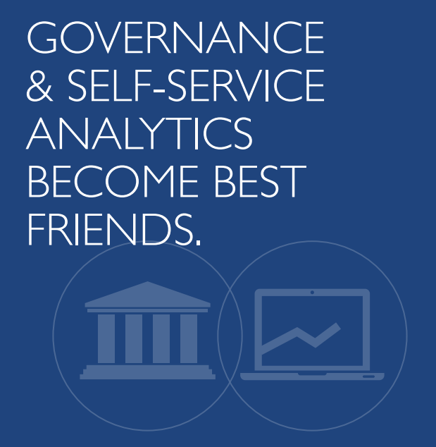
Notes:
Many people have considered governance and self-service analytics to be natural enemies. Maybe that’s why those people were surprised to see governance and self-service having a drink together. The war is over, and the cultural gap between business and technology is closing. Organizations have learned that data governance, when done right, can help nurture a culture of analytics and meet the needs of the business. People are more likely to dig into their data when they have centralized, clean, and fast data sources, and when they know that someone (IT) is looking out for security and performance.

Slide 5
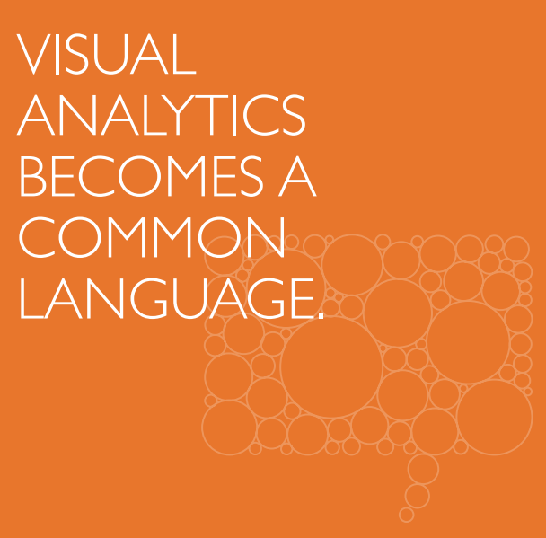
Notes:
Data is changing the conversation—in boardrooms, in the media, and in social media. People are visualizing their data to explore questions, uncover insights, and share stories with both data experts and non-experts alike. As data usage grows, even more people will turn to data with both professional and personal questions. And employers will look for candidates who can think critically with data. Visual analytics will serve as the common language, empowering people to reach insights quickly, collaborate meaningfully, and build a community around data.

Slide 6
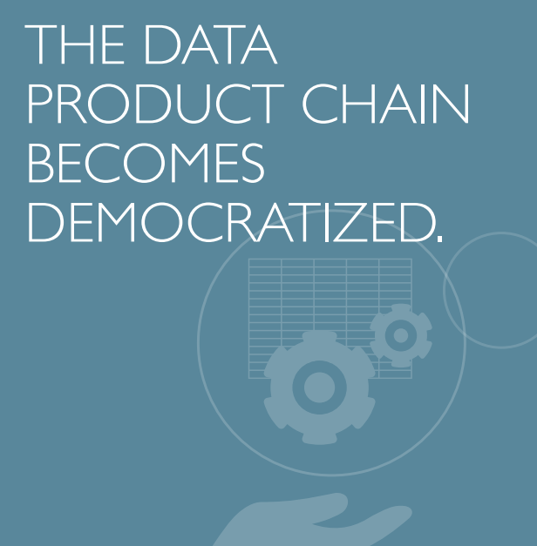
Notes:
Self-service analytics tools have changed people’s expectations for good. In 2016, people will seek empowerment across the data continuum, especially as more millennials enter the workforce. For business users to stay iterative, they must be able to shape certain data on the fly. That’s why the demand for self-service data preparation tools and even self-service data warehouses will grow as a natural extension of self-service analytics. This democratization will allow people to respond quickly to shifting priorities.

Slide 7
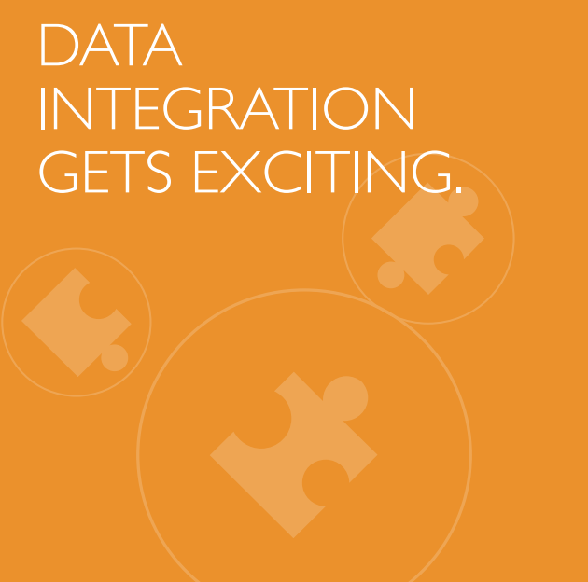
Notes:
These days many companies want agile analytics. They want to get the right data to the right people, and quickly. This is no small challenge, because that data lives in many different places. Working across data sources can be tedious, impossible, or both. In 2016, we’ll see a lot of new players in the data integration space. With the rise of sophisticated tools and the addition of new data sources, companies will stop trying to gather every byte of data in the same place. Data explorers will connect to each data set where it lives and combine, blend, or join with more agile tools and methods.

Slide 8
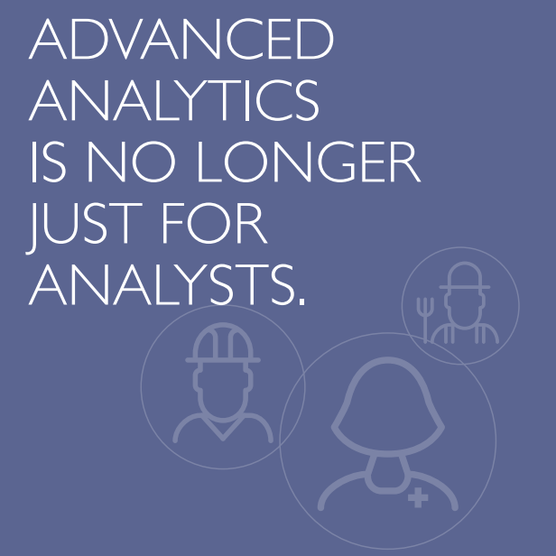
Notes:
Non-analysts across the organization are becoming more sophisticated. They’ve come to expect more than a chart on top of their data. They want a deeper, more meaningful analytics experience. Organizations will adopt platforms that let users apply statistics, ask a series of questions, and stay in the flow of their analysis.

Slide 9
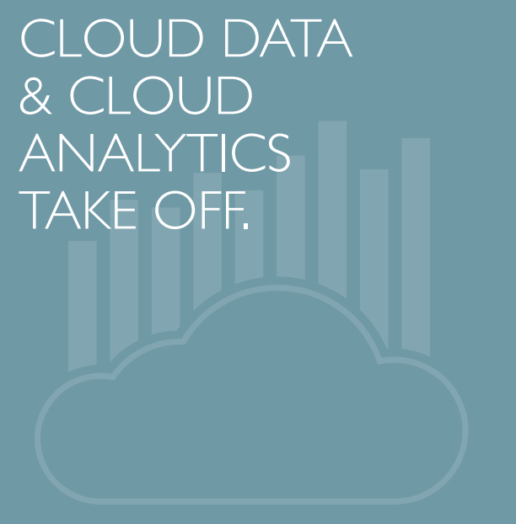
Notes:
In 2015, people began embracing the cloud. They realized putting data in the cloud is easy and highly scalable. They also saw that cloud analytics allows them to be agile. In 2016, more people will transition to the cloud thanks, in part, to tools that help them consume web data. Early adopters are already learning from this data, and others are realizing they should. And more companies will use cloud analytics to analyze more data faster. They’ll come to rely on it just like any other critical enterprise system.

Slide 10
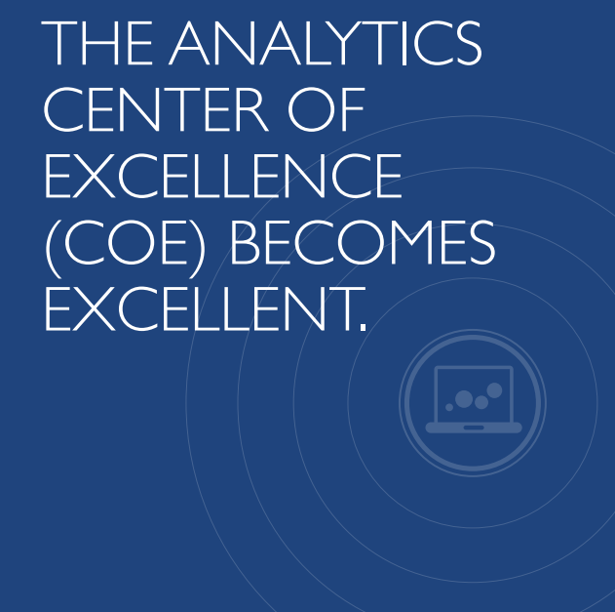
Notes:
An increasing number of organizations will establish a Center of Excellence to foster adoption of self-service analytics. These centers play a critical role in implementing a data-driven culture. Through enablement programs like online forums and one-on-one training, the centers empower even non-experts to incorporate data into their decision-making. Over time, these centers enable data to inform workflow across the entire organization.

Slide 11
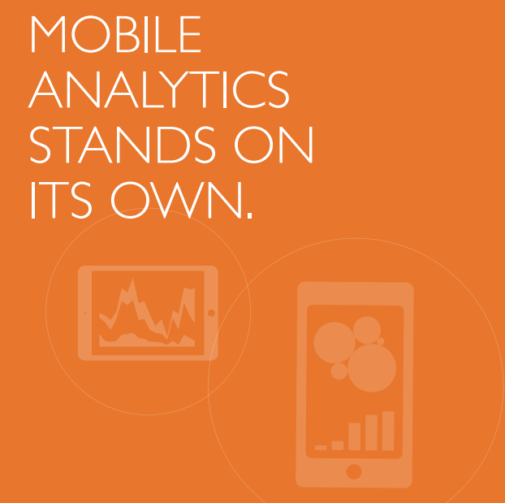
Notes:
Mobile analytics has grown up and moved out. It’s no longer just an interface to legacy business intelligence products. In 2015, products with a fluid, mobile-first experience began to emerge. Working with data out in the world is going from being a chore to becoming a dynamic part of the analytics process.

Slide 12

Notes:
The Internet of Things is poised to become even more prevalent in 2016. It seems that everything will have a sensor that sends information back to the mothership. Just think of all the data mobile devices are generating around the clock—and that’s just one piece. As the volume of IoT data grows, so does the potential for insights. Companies will look for tools that allow users to explore the data, then share their findings in a secure, governed, and interactive way.

Slide 13

Notes:
There are a number of new technologies in the BI ecosystem. As these go to market, we’ll see gaps that need to be filled. There will be new companies to do just that. Hadoop accelerators, NoSQL data integration, IoT data integration, improved social media—each of these provide an opportunity for a new company to start up. In 2016, we’ll see the rise of the gap fillers, leading to a market consolidation. And organizations will continue to shift away from single solutions and embrace an open and flexible stack that includes these new technologies.

Slide 14
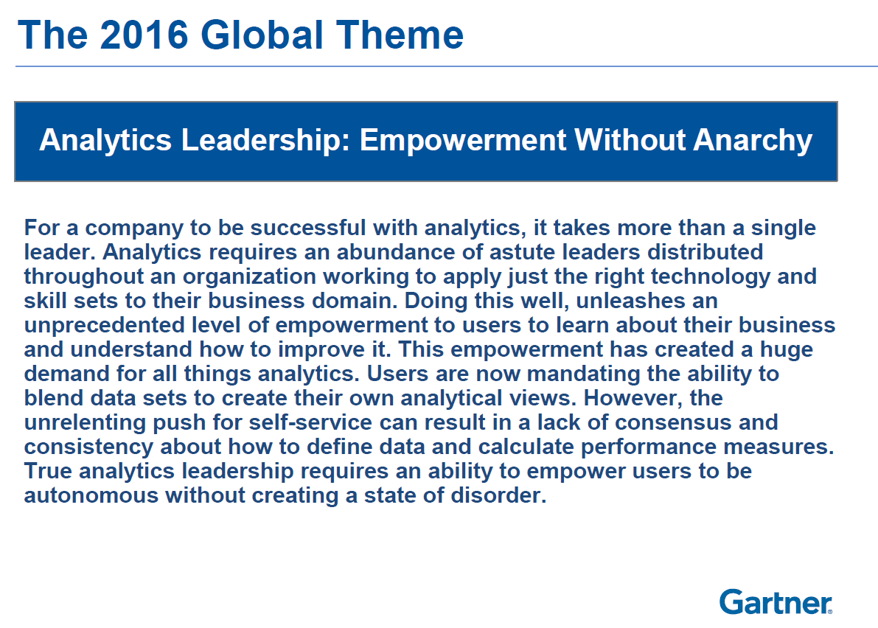
True analytic leadership requires an ability to empower
users to be autonomous without creating a state of disorder.

Slide 15
“Gartner introduced the concept of governed data discovery that refers to platforms that can address enterprise-level IT requirements as well as assist (non-IT) business users in data discovery.
No vendor has addressed both these aspects convincingly so far, but there is an indication that this convergence will happen.
Governed data discovery strives to find the right balance between allowing creativity so that end users can experiment with the data and maintaining just enough centralized control so that enterprise tasks can run smoothly.”
JUL 8, 2015

Slide 16
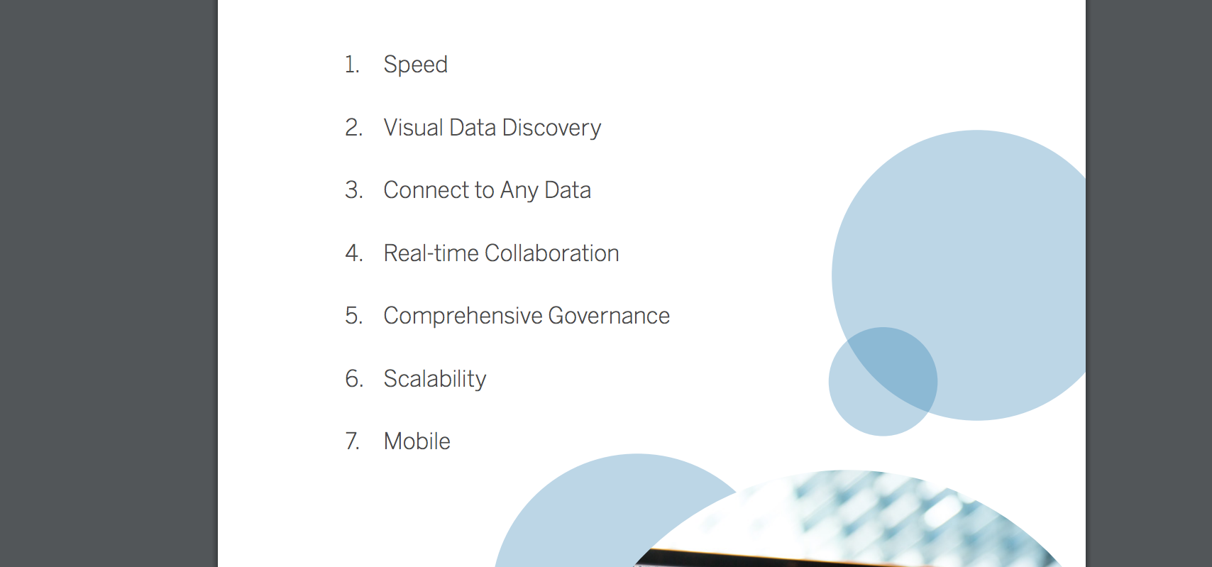
The Modern Approach to Business Intelligence
Speed
Visual Data Discovery
Any data
Real-time collaboration
Governance
Scalability
Mobile

Slide 17

Notes:
http://www.tableau.com/stories/customer/eliminating-reporting-bottleneck-ccbc#video1

Slide 18
Analytics Workflow Component | Enterprise-Reporting-Based Platform | Modern BI and Analytics Platform
Data source | Upfront dimensional modeling required (IT-built star schemas) | Upfront modeling not required (at les/at tables)
Data ingestion and preparation | IT-produced | IT-enabled
Content authoring | Primarily IT staff, but also some power users | Business users
Analysis | Structured ad hoc reporting and analysis based on a predened model | Free-form exploration
Insight delivery | Distribution and notifications via scheduled reports or a portal | Delivery via sharing and collaboration, storytelling, and open APIs

Slide 19
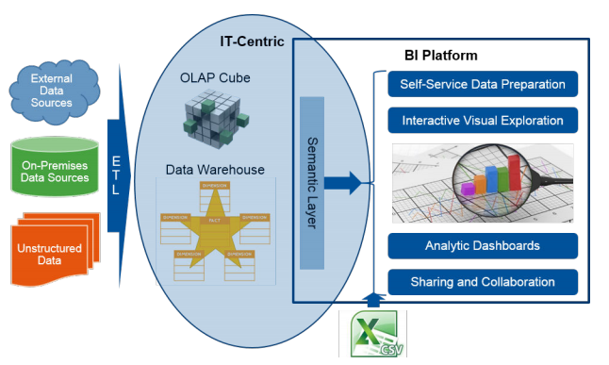
Notes:
Enterprise Reporting Systems

Slide 20
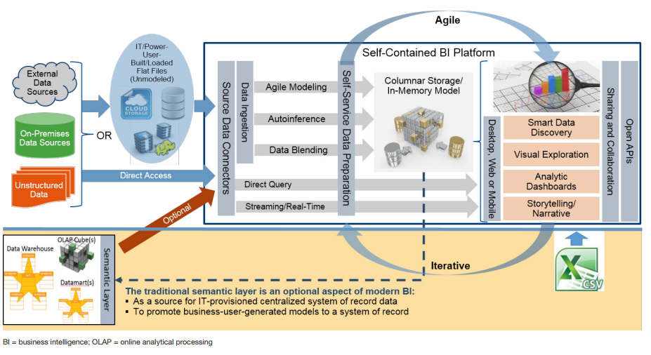
Notes:
Modern BI and Analytics Platform

Slide 21
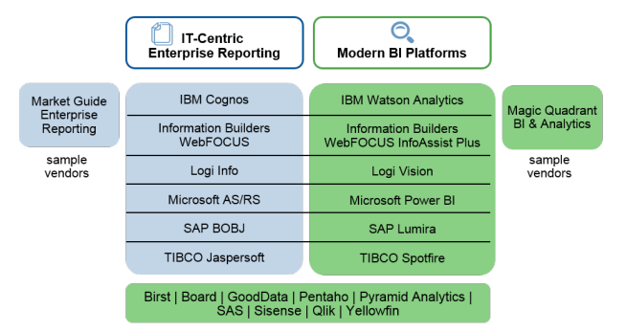

Slide 22
Notes:
http://get.tableau.com/gartner-magic-quadrant-2016.html
(For reference: Gartner Magic Quadrant survey consists of analyst opinions and customer opinions, as gleaned from their BI-related inquiries to Gartner; an online survey of vendors' customers conducted during October 2014 (which yielded 2,083 responses); a questionnaire completed by the vendors; vendors' briefings, including product demonstrations, strategy and operations; an extensive RFP questionnaire inquiring how each vendor delivers specific features that make up the 13 critical capabilities (a toolkit with the RFP template will be published soon after this Magic Quadrant); a prepared video demonstration of how well vendor BI platforms address the 13 critical capabilities; and biscorecard.com research.)
What makes up the two axes – “ability to execute” and “completeness of vision”?
X: Completeness of vision – Gartner analysts evaluate providers on their ability to convincingly articulate their current and future market direction, innovations, customer needs, and competitive forces, as well as how they map to the Gartner position. In other words, does this provider understand how market forces can be exploited to create opportunities for itself? Criteria here include market understanding, marketing strategy, sales strategy, product strategy, business model, industry/geographic strategy, innovation, and geographic strategy (new in 2016).
Y: Ability to execute – Can the providers successfully capitalize on their vision? This is about the quality of products and services, overall viability of the company, ability to respond to the market as customer needs evolve and market dynamics change, and customer experience. Marketing Execution and Operations NOT rated in 2016.
What is the criteria for the Magic Quadrant?
Criteria for the MQ is not static, they get updated each year to reflect changing market dynamics and user requirements. Vendors are evaluated based on key use cases Gartner sees. The Critical Capabilities Use cases are:
se Cases
Work flows
Agile Centralized BI Provisioning
Supports an agile IT-enabled workflow from data to centrally delivered-and-managed content using self-contained data management capabilities of the platform.
Decentralized Analytics
Supports a workflow from data to self-service analytics.
Governed Data Discovery
Supports a workflow from data to self-service analytics to systems-of-record, IT-managed content with governance, reusability and promotability.
OEM / Embedded BI
Supports a workflow from data to embedded BI content in a process or application
Extranet Deployment
Supports a workflow similar to Agile Centralized BI Provisioning for external customer access.

Slide 23
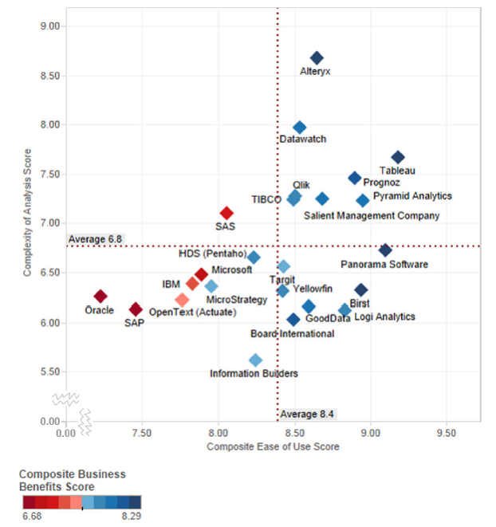
Capability/Platform Functionality
Notes:
As we look more closely at product capability, we’ll see in this chart that tableau is well positioned with product capability and ease of use – thus driving modest size deployments and overall business benefits. Gartner stated that conversations revealed a level of enthusiasm in being able to rapidly leverage insights from Tableau to impact the business. Tableau also continues to invest in R&D at a higher pace than other vendors to further its mission.

Slide 24
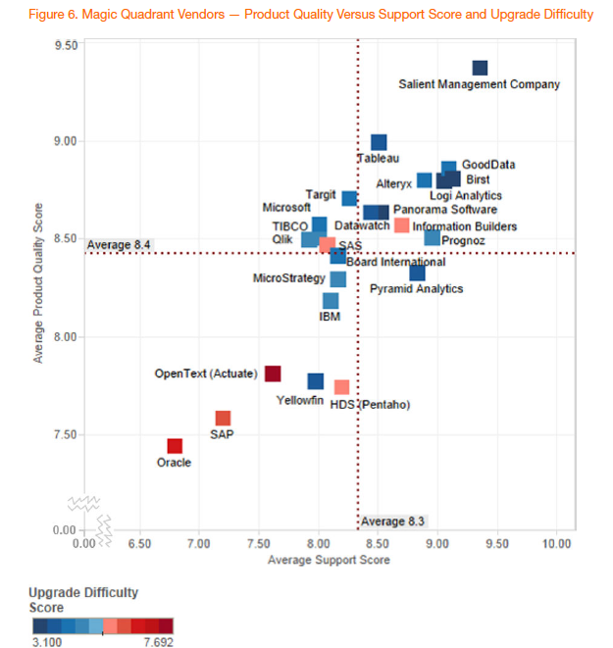
Quality/Platform Functionality
Notes:
Tableau ranks high with not only with product quality but with the support that goes with it. These are key components of customer experience and go hand in hand with ease of upgrade which is reflected in a low upgrade difficulty score.

Slide 25
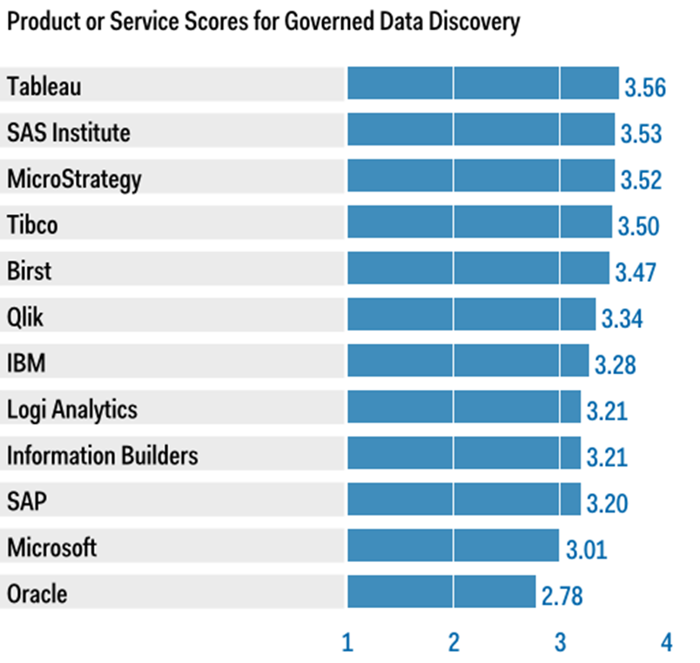
Critical Capabilities for BI
Source: Gartner, “Critical Capabilities for Business Intelligence and Analytics Platforms”, May 2015.
Notes:
As an outcome of the magic quadrant in identifying a shift in the market to data discovery, Gartner further explored how vendors supported and balanced ease of use for business users while providing an IT governed environment. In a complementary report to the magic quadrant, Gartner stated, “Data discovery vendors that excel at decentralized and governed data discovery are the easiest to use, deliver higher business benefits, and enable a broader set of users to conduct more complex and advanced types of analysis without the [direct] assistance of IT. They also deliver higher business benefits than most other vendors.” Tableau was well positioned by Gartner as the highest ranked vendor for governed data discovery.

Slide 26
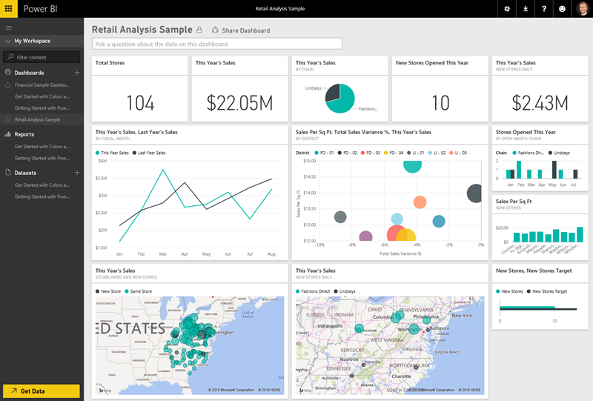
Microsoft PowerBI
Notes:
Microsoft
“Microsoft is the overall vision leader in the Magic Quadrant as it has the most complete vision of all vendor included as its BI and analytics leadership team has clearly demonstrated its commitment and focus to Power BI. Power BI is at the center of Microsoft’s Azure story which includes Azure ML, HD Insights, Stream Analytics, etc. which solidifies its status as an area of continued strategic investment and innovation. Cortana Analytics is an umbrella for several of these offerings. Its market execution of Power BI 2.0, which was released in July 2015, is greatly improved compared to its initial launch of Power BI that failed to gain any traction in the market due to the confusing packaging, positioning and infrastructure prerequisites that few organizations could easily satisfy.”
PowerBI has gotten points with Gartner this year for giving users a streamlined workflow in providing self-service data prep, data discovery and dashboards in a low-cost package. What’s changed from 2014 is that it no longer dependent on Excel for authoring, and does not require SharePoint for content distribution when deployed via Azure Cloud. MS is expanding its partner ecosystem to provide mobile, pre-packaged connectors and dashboard content.
Strengths
“Microsoft's cloud-based delivery model and low per-user pricing offers a low TCO — one of the top three reasons why customers selected it, in addition to ease of use for business users and the availability of skilled resources.”
“Microsoft has substantially lowered the price of Power BI — from its original $39.95 per user per month to $9.95 per user per month — making it one of the lowest-priced solutions on the market. The lower price point, in addition to substantial product improvements, explains the strong uptake by 90,000 organizations (according to Microsoft).”
“Microsoft ranks in the top quartile for achievement of business benefits, with high scores in its use for monetizing data, improving customer service and increasing revenue, as well as delivering better insights to more users.”
“Microsoft now has prebuilt connectors (and content) to Facebook, Salesforce, Dynamics CRM, Google Analytics, Zendesk and Marketo, to name a few.”
“Microsoft's vision to provide natural-language query and generation via its Cortana personal digital assistant, together with its strong partner network and its strategy to provide prebuilt solutions, positions it furthest to the right on the Completeness of Vision axis.”
Weaknesses
“The newness of the product and its cloud only delivery model may contribute to Microsoft's ranking in the bottom third for deployment size, with an average of 192 users. Eleven percent of surveyed customers cited the inability to support a large number of users as a limitation to broader deployment.”
“Microsoft scores low on product capabilities for advanced analytics within Power BI. Even simple forecasting must be done externally within Excel.”
“Microsoft was rated in the bottom quartile for breadth of use, which looks at the percentage of users that use the product for a range of BI styles from viewing reports, creating personalized dashboards and doing simple ad hoc analysis, to performing complex queries, data preparation and using predictive models. Microsoft Power BI is mainly being used for parameterized reports and dashboards”
“Microsoft was ranked in the bottom quartile for sales experience by survey references. This can be partly attributed to its frequent changes in pricing and packaging, as well the lack of a BI and analytics-focused sales force.”

Slide 27
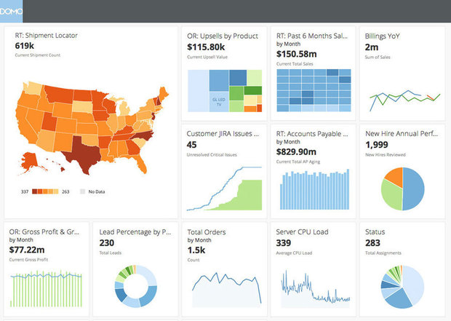
Domo
Notes:
Domo
Although Domo has been making a lot of noise in the market place, Gartner considers them a niche player and says their “primary focus on delivering easy-to-use management dashboards to executives and business users which is a relatively narrow focus in this market and lacks overall product vision relative to the other vendors on the Magic Quadrant.” Domo lacks the data discovery aspects and visual analytics depth core to Tableau. So, they are not a solution for analysts and BI experts.”
In addition, Domo is cloud-based only, in which all data (whether it’s stored on-premises or in cloud applications) need to be moved to Domo’s cloud data store, limiting a customer’s choice in keeping their data on-prem. On data exploration limitations – Domo’s data cannot be modeled into hierarchies. It lacks adhoc query capabilities. Filtering on a dashboard is limited and there’s no advanced data exploration capabilities. Gartner’s inquiries with customers found a wide range of prices, depending on the number of users and date of adoption. Prices range from $750 to $1500 per user, plus a $60,000 platform fee (source: Gartner Domo Brings Cloud-Based Dashboards to Business Executives).
“Domo's primary focus is on rapid deployment of easy-to-use management dashboards to executives and business users, which is a relatively narrow focus in this market
“Gartner inquiries for Domo are up significantly this year, and there were almost 500 searches for "Domo" on gartner.com during the past year, which is only slightly less than for "Qlik" (though only about one quarter the number for "Tableau").
“Domo's cloud-only approach may not suit organizations with primarily on-premises data sources. Domo offers a desktop tool for loading on-premises data into its cloud, but this tool is less business friendly than other components of the platform.”
“Its data discovery features are works in progress, particularly when compared with the market leaders. This is consistent with, and the reason for, Domo's below-average score for complexity of analysis.
“Domo's support is rated in the bottom quartile and customers cite this (more than with most other vendors) as one of the biggest limitations to its broader deployment.”
“training, availability of skills and user community are rated as below average.

Slide 28
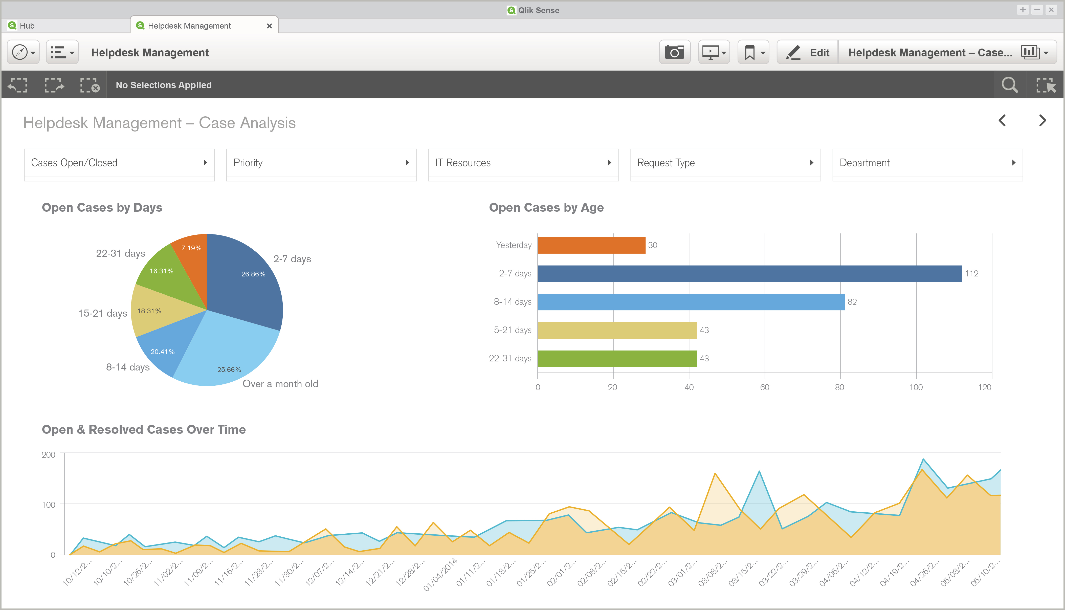
Qlik
Notes:
Qlik has dramatically improved and clarified its messaging to the market around Qlik Sense and QlikView which positions Qlik Sense Enterprise as Qlik’s strategic product build upon the Qlik Analytics Platform and underlying QIX Associative Engine, which now also powers Qlik View beginning in Version 12. Qlik Sense 2.x has closed a significant number of gaps that were present when Qlik Sense 1.x was released.
There are still gaps in terms of ease of use and overall analytic workflow but Qlik continues to deliver releases at a rapid cadence which will continue to improve the overall offering.
Qlik is positioned to the right of Tableau for completeness of vision primarily based on its future vision for Qlik Market, DaaS strategy through its acquisition of DataMarket, application platform approach with the Qlik Analytics Platform (QAP), unique associative engine (QIX) and governed data discovery roadmap.”
“Cost of software was cited as a barrier to adoption by 29% of Qlik's reference customers, putting it in the top quartile for this barrier.
In larger deployments (of more than 500 users), its pricing is 70% higher than chief competitor Tableau and almost double Microsoft's three-year license fee.
Qlik scored slightly below average for customer support (which includes level of expertise, response time and time to resolve).
Twenty-three percent of Qlik's reference customers cited absent or weak functionality as a platform problem, indicating that Qlik Sense still has some functionality gaps to address — most notably in terms of mobile, advanced analytics, scheduling and collaboration. Qlik has been slow to enter the cloud market directly, relying on its partners for cloud deployments.

Slide 29
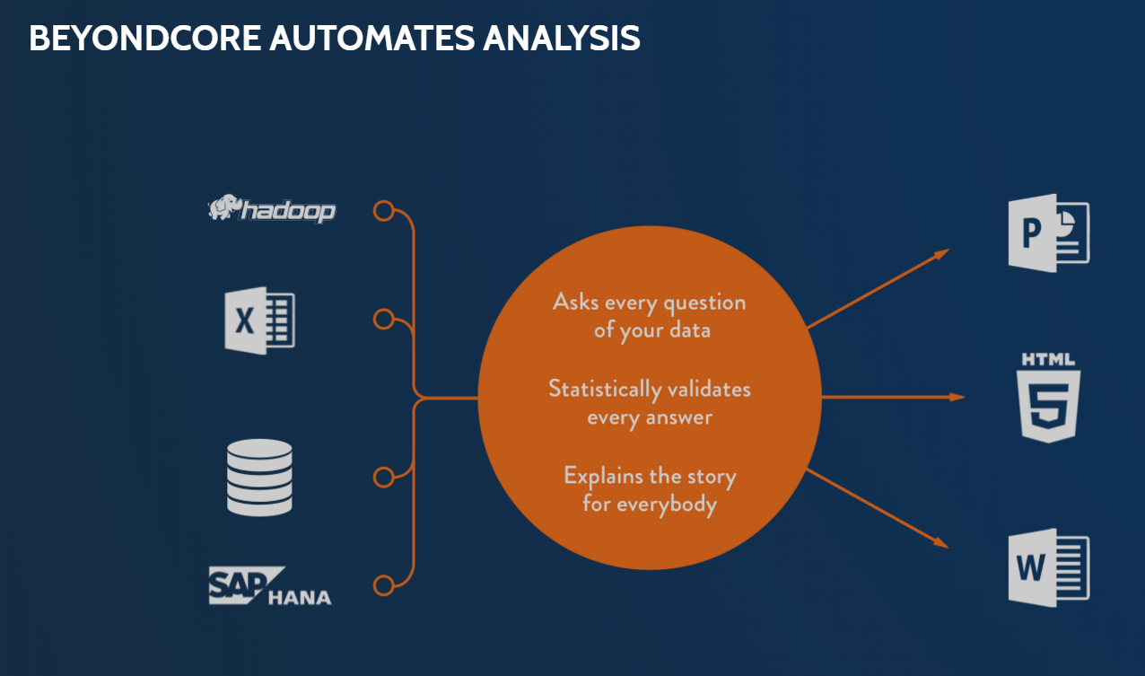
BeyondCore
Notes:
BeyondCore is a new entrant to the 2016 MQ. They are a startup that “combines automated smart pattern detection with natural language generation of findings and spans the full spectrum of analytics from descriptive to prescriptive”. Gartner thinks they’ve got strong product vision, but lack market traction. They have a free version of their software available as an add-in to Excel to generate market awareness.

Slide 30
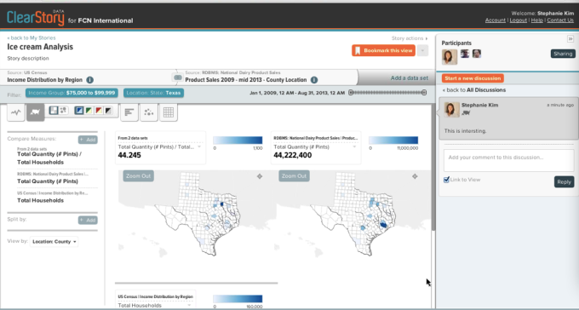
ClearStory
Notes:
Clearstory is new entrant to the 2016 MQ, positioned as “an end-to-end analytic workflow enablement solution from data harmonization to delivery of insights through stories. Data inference capabilities are a differentiator – they solve difficult data integration problems for customer few vendors can compete”. They are a startup with relatively weak execution and market momentum.

Slide 31
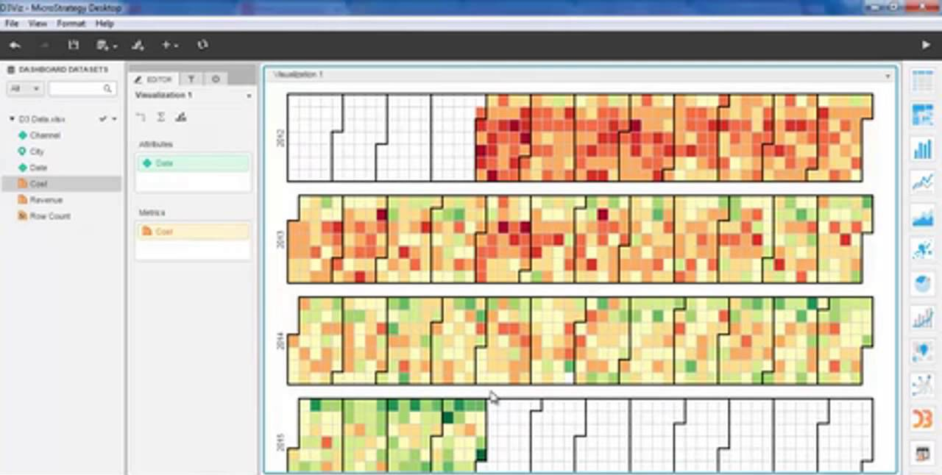
Microstrategy
Notes:
With the rise of data discovery, enterprise business intelligence (BI) and analytic vendors that have focused on IT-authored reports against modeled data warehouses have been challenged. As the likes of Tableau and Qlik have made inroads in MicroStrategy's installed base, MicroStrategy has been gradually improving its capabilities to strike the balance between agile and enterprise scale.
MicroStrategy version 10 combines self-service data preparation, visual data discovery and big data exploration with enterprise business intelligence, bringing the vision for a single-vendor solution within reach of BI and analytics leaders. Providing both systems-of-record reporting and agile, self-service BI capabilities — with integration between the two.

Slide 32
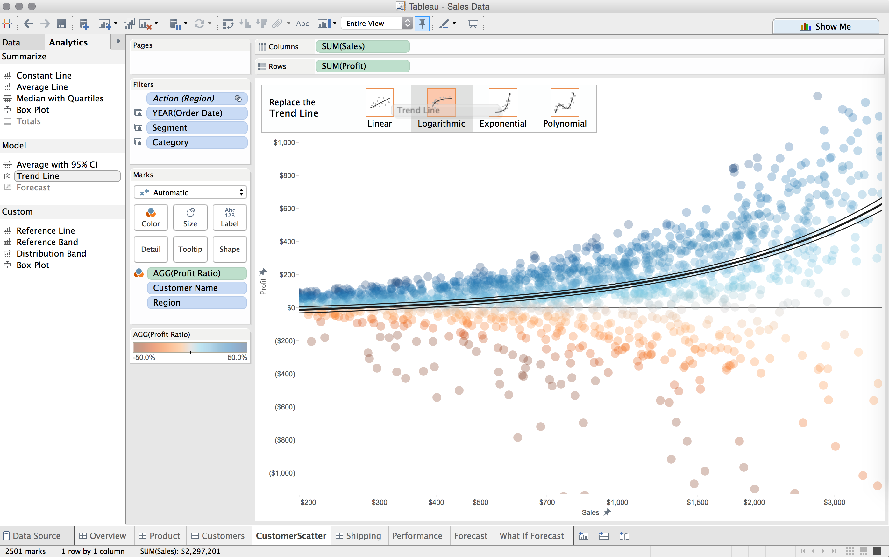
Tableau
Notes:
“Tableau’s focus on making its customers successful is evident in its top overall rating of all Magic Quadrant vendors for customer enablement.” Tableau is again (4th year in a row) the market leader in terms of overall execution.
“Tableau continues to execute better than any vendor in the BI market and its land-and-expand sales model has performed extremely well, resulting in a dramatic increase in large enterprise deals”
“A core strength of Tableau is its versatility, both in terms of deployment options across cloud and on-premises as well as the use cases it can be deployed against.”
So why did we drop?
“When asked about limitations to a wider deployment, 44% of Tableau's survey references cited the cost of software as a barrier.”
“Reference survey input suggests that Tableau is experiencing the growing pains that often accompany rapid growth”
“…offers little support when it comes to integrating combinations of these sources in preparation for analysis. In order to compensate for this weakness, a growing number of Tableau customers have turned to vendors specializing in self-service data preparation…which magnifies the TCO concerns
“...shifting of data preparation to a separate product could potentially marginalize Tableau as the front-end visualization space becomes increasingly commoditized and more difficult to differentiate.

Slide 33
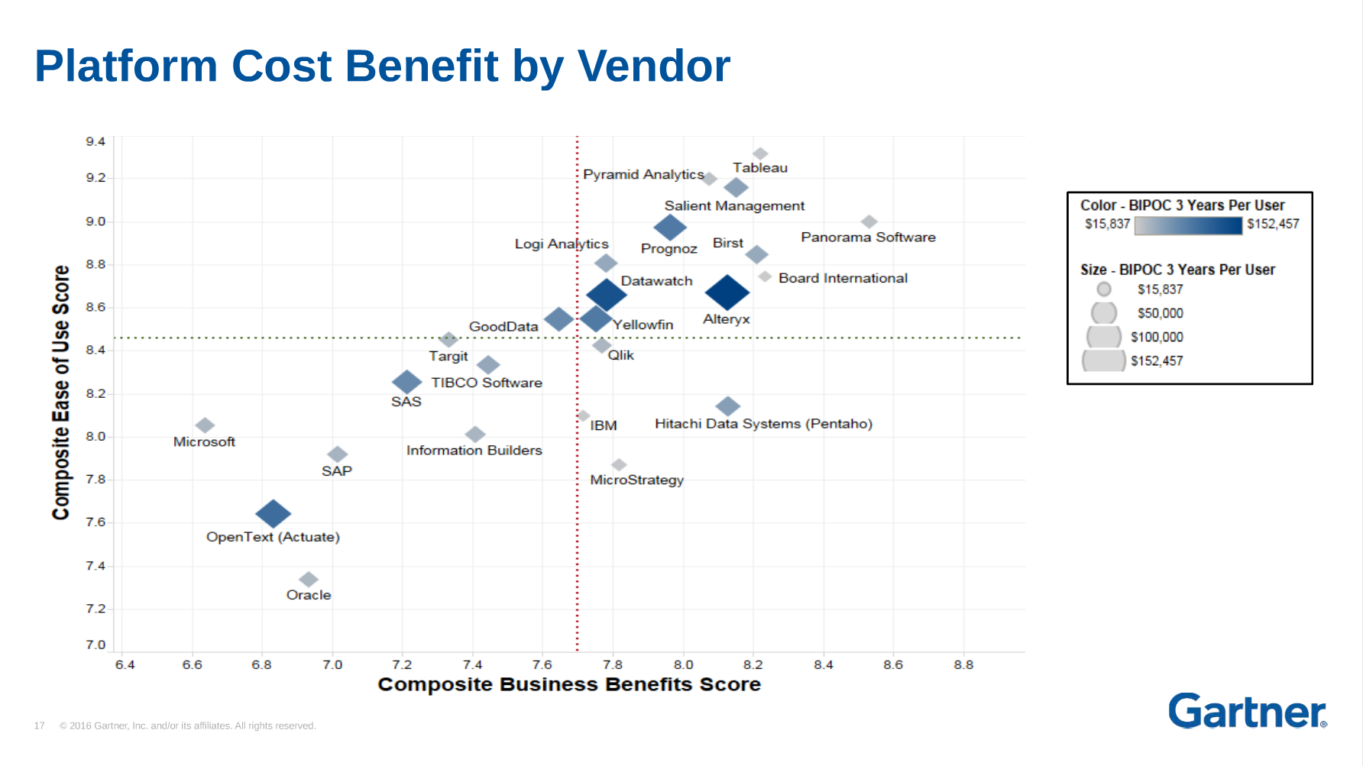
Notes:
“With increased price sensitivity in this market, coupled with Tableau's reluctance to respond with a more attractive enterprise pricing model have probably affected its sales execution survey rating this year and contributed to the drop in its position on the Ability to Execute axis compared with last year (where Tableau dramatically outperformed the competition).”

Slide 34
WHY IS TABLEAU DIFFERENT?

Slide 35
Demo

Slide 36
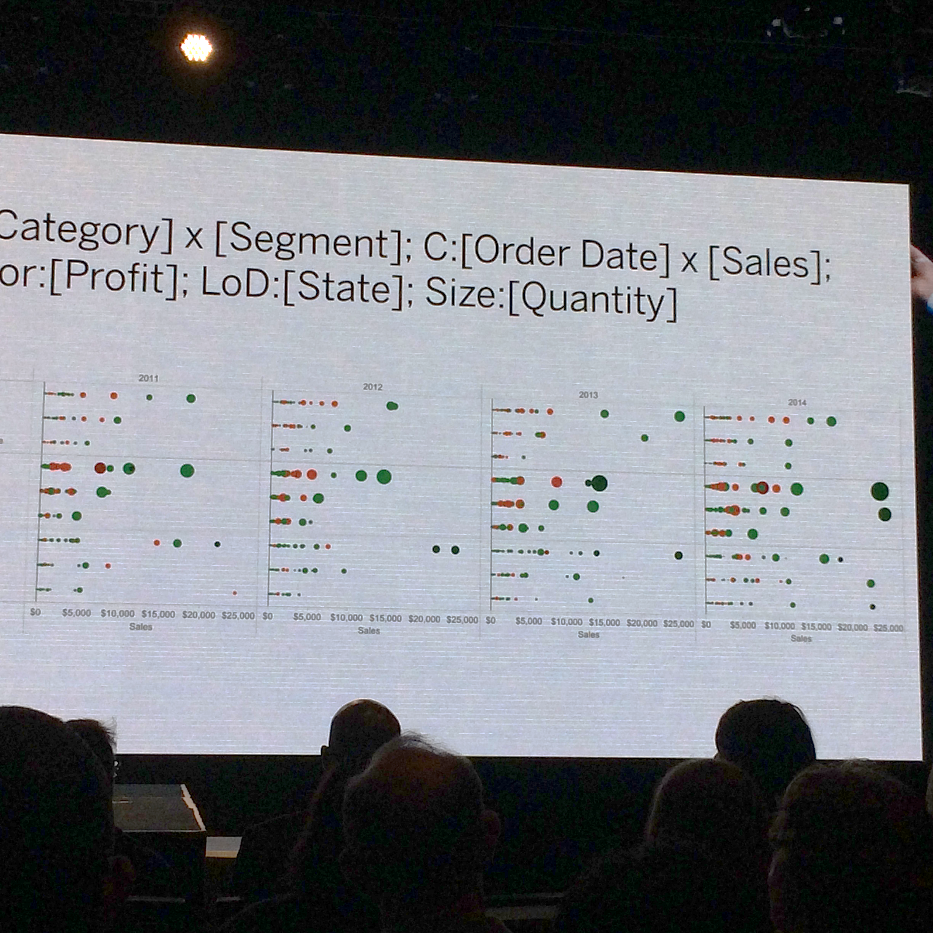
DEMO

Slide 37
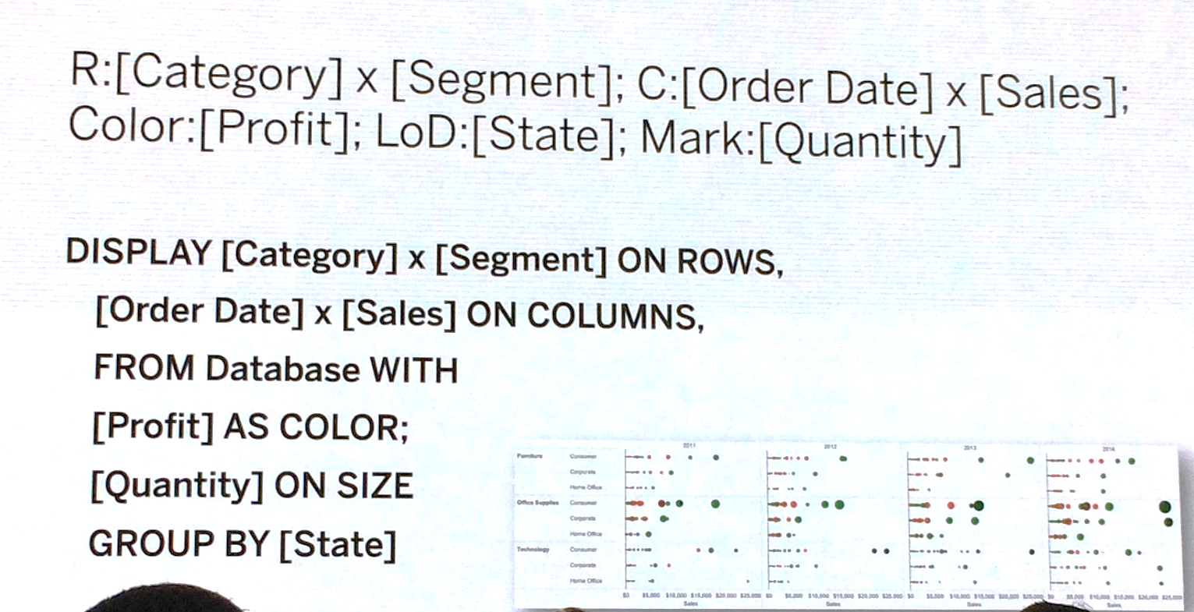

Slide 38
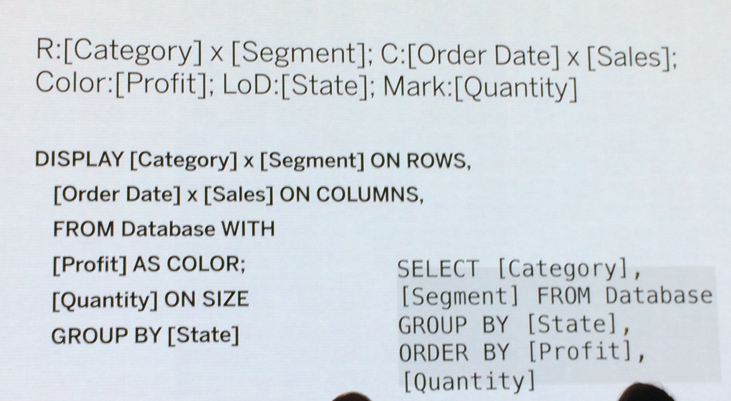

Slide 39
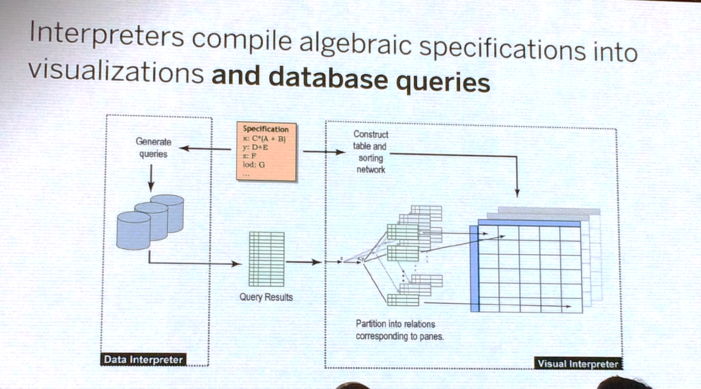

Slide 40
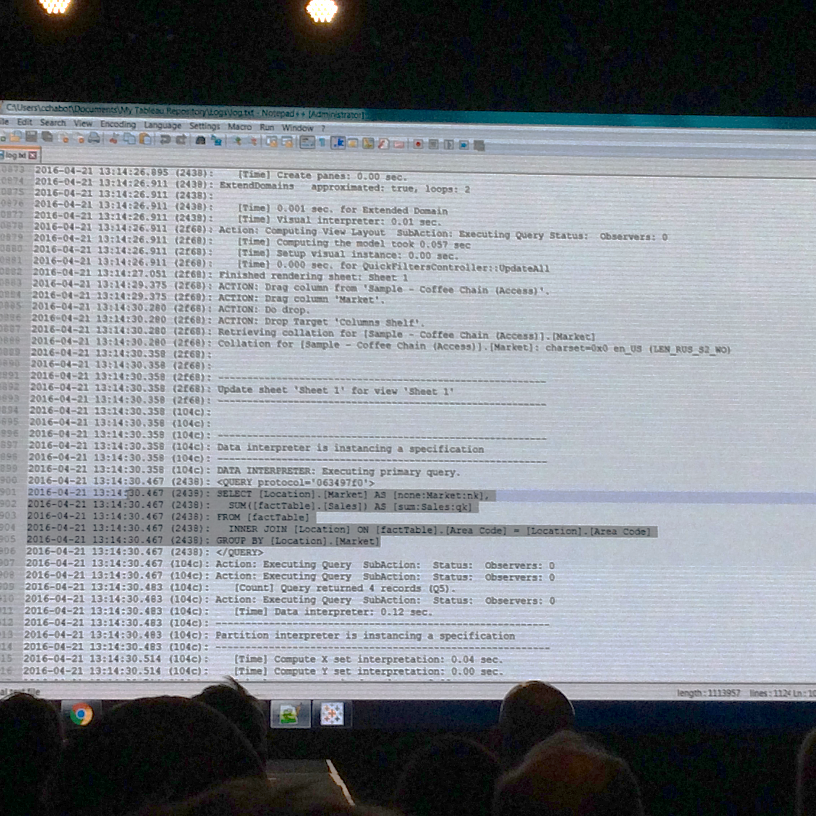

Slide 42
Today’s Lesson: Trends in Business Intelligence Role of IT Mobile Business Intelligence Exercise Tour of Alpo Hands on with Tableau Online

Slide 43

Notes:
http://www.tableau.com/stories/customer/eliminating-reporting-bottleneck-ccbc#video2

Slide 44
IT is responsible for… security integration scalability data governance monitoring & management high availability and disaster recovery

Slide 45

security
Protecting:
Data
People
Property
Resources
Authentication
Authorization
Shadow IT

Slide 46

integration
Into
Out from
Partners
Vendor Agnostic
Services

Slide 47

scalability
Making sure everything runs smoothly
Technology
Licensing
Scaling Up & Out
People
Processes

Slide 48

data governance
Right data to the right people
Regulations
Single-source of Truth
Data lineage
Content lifecycle

Slide 49

monitoring and management
Being notified of performance, security, and content
Auditing
Performance planning
On boarding
Partners

Slide 50

high availability & disaster recovery
Service stays available when failures occur
Uptime promise
SLA’s - 9’s - 99.99%
Backup and recovery in case of failure

Slide 51

IT is responsible for… security integration scalability data governance monitoring & management high availability and disaster recovery

Slide 52
Today’s Lesson: Trends in Business Intelligence Role of IT Mobile Business Intelligence Exercise Tour of Alpo Hands on with Tableau Online

Slide 53

Notes:
http://www.tableau.com/stories/customer/eliminating-reporting-bottleneck-ccbc#video3

Slide 54
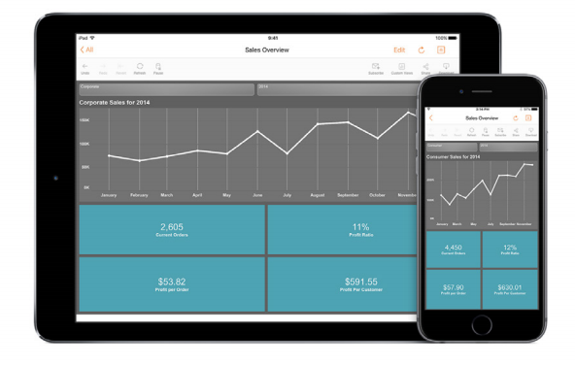
Mobile BI
Notes:
looking to Dresner’s “Mobile Business Intelligence Market Study”, the importance of mobile BI is growing. The study found that BI ranked second in mobile priorities and trails only email.
BI is increasing importance while email is losing ground, and this trend is expected to continue. Since 2010, when Dresner chartered its first mobile business intelligence market study, they’ve seen a steady perception of value among organizations they sampled.
The study also found that in 2014, mobile BI has become a core tenant of organizational culture in more organizations. Those “completely prepared” or “somewhat prepared” represent a large majority of respondents, which indicates that organizations are more comfortable with the use or prospect of mobile BI than in the past.
Just as the cloud has moved quickly from a scary new thing to a must-have asset, mobile BI is here to stay. With proper support of the user’s context and intent, and a dashboard designed for the mobile user, mobile BI can make a business smarter and faster.

Slide 55
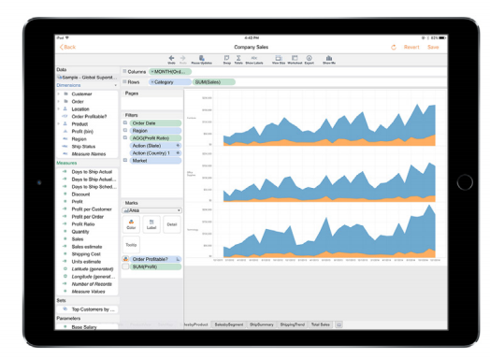
Paradigm Shift 1: Understanding Context
Notes:
Our smartphones have taught us to expect speed and convenience. We don’t want to carry around a laptop or tablet if we don’t have to, and we don’t want to be chained to an office. Whether we’re in a coffee shop, a restaurant, a hotel lobby, or on an airplane, we want access to the necessary data, and we want it now. And more and more people are working from home or traveling as a major part of their job. For them, having quick, reliable access to data is a requirement, not a luxury. The increased capabilities of smartphones and self-service analytics solutions have made all of this possible.

Slide 56
“At Coke Consolidated, mobile is a key. We try to make sure our sales force is not stuck in the office, because we’re primarily responsible for selling the product. And spending time in an office looking at metrics, crunching numbers is not their job. Their job is to sell product.” — Shawn Crenshaw, Senior Business Analyst Coca-Cola Bottling Company Consolidated
Notes:
For example, at Coca-Cola Bottling Company Consolidated, the sales team is equipped with mobile devices that provides access to data needed to make sales.
http://www.tableau.com/stories/customer/eliminating-reporting-bottleneck-ccbc
“At Coke Consolidated, mobile is a key. We try to make sure our sales force is not stuck in the office, because we’re primarily responsible for selling the product. And spending time in an office looking at metrics, crunching numbers is not their job. Their job is to sell product.” — Shawn Crenshaw, Senior Business Analyst, Coca-Cola Bottling Company Consolidated Even just a few years ago, the hardware and software would not have allowed a salesperson to instantly access sales data while meeting with a client outside of the office. Now this speed to an answer is becoming the norm.

Slide 57
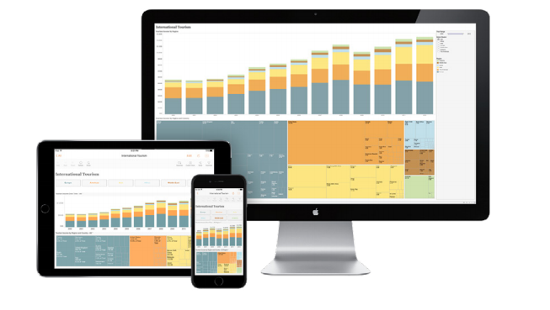
Paradigm Shift 2: Understanding User Intent
Notes:
As companies ponder the possibilities of mobile BI, there are several workflows that should be optimized for the different use cases that frequently arise when on the go. The workflows can be summarized in four steps: explore, see, engage, and collaborate.

Slide 58
Explore See Engage Collaborate
Notes:
Explore
It’s no accident that google as a verb is one of the defining words of our age. It’s increasingly easy to explore information, and businesses need to make their data easy to explore, too, especially for those out in the field or in the trenches. Without the ability to quickly browse or search to find the dashboard you need on your mobile device, you’re lost.
See
With mobile BI, you want answers to your questions right away. Seeing your data is all about quickly understanding your most important data at a glance. Useful mobile dashboards are simple, highlighting the critical information.
Engage
Sometimes consuming data goes beyond simply glancing at it. It requires diving deeper. Great dashboards allow for engagement; they’re not a one-way conversation. In other words, mobile BI should let you ask and answer questions, not just give you predetermined stats. For example, can you filter to another segment or territory? Can you drill down on data? In some cases, you need to ask totally different questions or obtain a better understanding of the underlying data. For example, can you add order data to the sales report to answer an entirely new question?
Mobile editing is powerful, but is often used by a smaller subset of users under certain conditions. Device constraints are also important; editing should be limited to devices with a large enough screen to have an analytically significant experience—said another way, editing on mobile should be optimized for mobile and not painful.

Slide 59
Explore See Engage Collaborate
Notes:
Engage
Sometimes consuming data goes beyond simply glancing at it. It requires diving deeper. Great dashboards allow for engagement; they’re not a one-way conversation. In other words, mobile BI should let you ask and answer questions, not just give you predetermined stats. For example, can you filter to another segment or territory? Can you drill down on data? In some cases, you need to ask totally different questions or obtain a better understanding of the underlying data. For example, can you add order data to the sales report to answer an entirely new question?
Mobile editing is powerful, but is often used by a smaller subset of users under certain conditions. Device constraints are also important; editing should be limited to devices with a large enough screen to have an analytically significant experience—said another way, editing on mobile should be optimized for mobile and not painful.
Collaborate
Just as it’s easy to share your thoughts about your favorite sports team on Twitter, you should be able to easily share your mobile analytics and insights with the right people. That includes your co-workers, supervisors, or clients in a controlled and secure manner. BI doesn’t work well in a vacuum. It requires collaboration. If you can’t collaborate easily, it’s not worth much. Underlying all four stages is the importance of security and governance. Each individual in an organization should be allowed access to the proper level and type of data—and only that. No one should explore, see, engage with, or collaborate on what’s beyond the scope of their job function. Additionally, governance policies on mobile should extend the standard governance policies of an organization so there are not two sets of rules and processes governing data

Slide 60
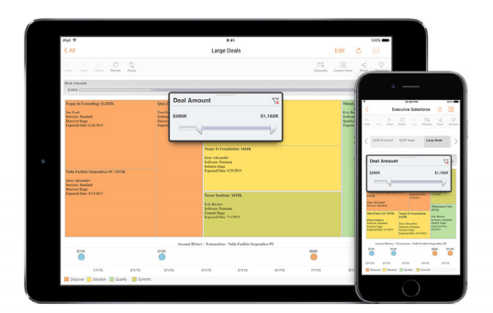
Paradigm Shift 3: Designing for Mobile
Notes:
Your mobile BI experience should be as enjoyable as your desktop BI experience. But a great desktop experience can’t be directly ported to mobile; you need to think a little differently.
Dashboards that are eye-catching and engrossing on a desktop don’t necessarily translate to great dashboards on mobile. There will always be adjustments, particularly when it comes to size, orientation, and interaction principles. Smaller phone screens force authors to simplify and reorient their dashboards. Many desktop dashboards are designed with a landscape orientation optimized for modern widescreen laptops. However, content consumption on phones is often done in portrait mode.
Depending on the data and use case, a portrait orientation might be more appropriate. Scroll design is also critical. Designing dashboards to have a fixed width, which limits side-to-side scrolling, can enable authors to focus on a great vertical scroll experience. Interactions on mobile devices are fundamentally different.
Forget right click, control+c, and control+z, instead, we tap, flick, pinch, and drag to explore data. To focus the dashboard, minimize the number of filters and avoid global filters. Global filters are powerful for desktop analysis, but according to user testing, they often frustrate mobile users because of accidental hand or palm taps. Author once, consume anywhere

Slide 61
Today’s Lesson: Trends in Business Intelligence Role of IT Mobile Business Intelligence Exercise Tour of Alpo Hands on with Tableau Online

Slide 62
It’s a Balancing Act
Self Service
Simple Metadata
Rapid Change
Control
Data Cleansing
Column Level Security
Row Level Security

Slide 63

Governed vs Ungoverned Access
Desktop User
Data Source
User connects directly to data, requiring data drivers and ungoverned access
Tableau Server
(Governed Access is a component)
Data Source
Desktop \ Browser \ App User
Tableau Data Source
Tableau Data Source
Tableau Data Source
User connects directly to Tableau Server where access to the data is through governed Tableau Data Sources

Slide 64
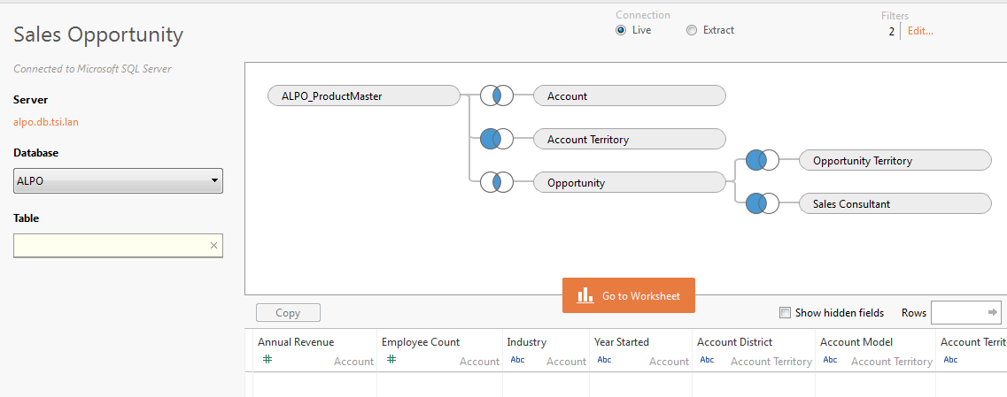
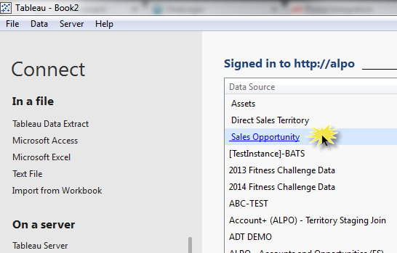
Datasources

Slide 65


Content Structure and Ownership
Server:
Sales
SSE
Certified
Finance
Prod
Forecast
Etc.
Regional Forecast
Etc.
SSE
Certified
Sites:
(2+)
Projects:
(2+ per Site)
Workbooks:
(5+ per Project)
Views:
(5-10+ per Workbook)

Slide 66
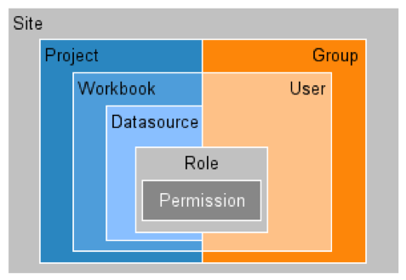
Object Level Security & Permissions
AD Groups map to Projects
All Workbooks and Datasources in that project will be accessible by all AD users in that group
e.g. it inherits permissions from the Project it is published into
AD Users can map to specific Workbooks and Datasources, but not necessary

Slide 67
IT Managed Deployment
Content will be separated into SSE (Self Service Environment) and Certified Environment through use of Project or Sites
- IT owns ‘standardized/blessed’ data sources
- IT owns review process for publishing any content to Prod
- Business owns all content in SSE (Self Service Environment)
Type | Business or IT | Server License | Desktop License | Create New Content | User Split
Web Consumer | Bus | Y |  | N | 80%
Web Consumer /Casual Editor | Bus | Y |  | Y (web editing) | 5%
Builder (aka Analyst, Power User) | Bus or IT (probably both) | Y | Y | Y (can publish to SSE) | 10%
Publisher / Admin | IT | Y | Y | Y (can publish to Prod) | 5%

Slide 68
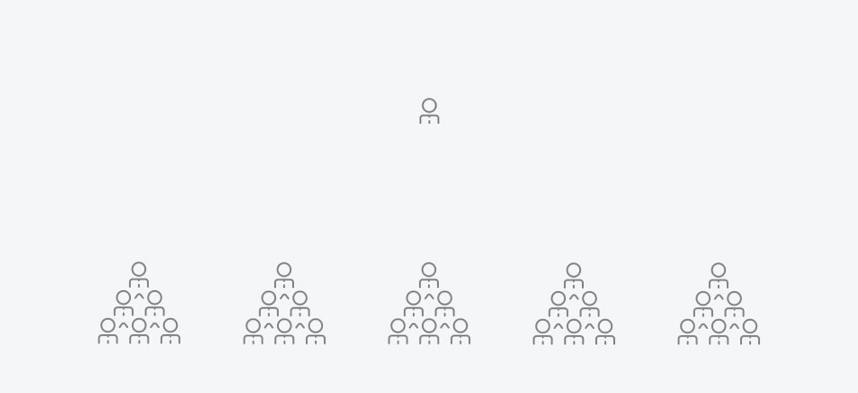
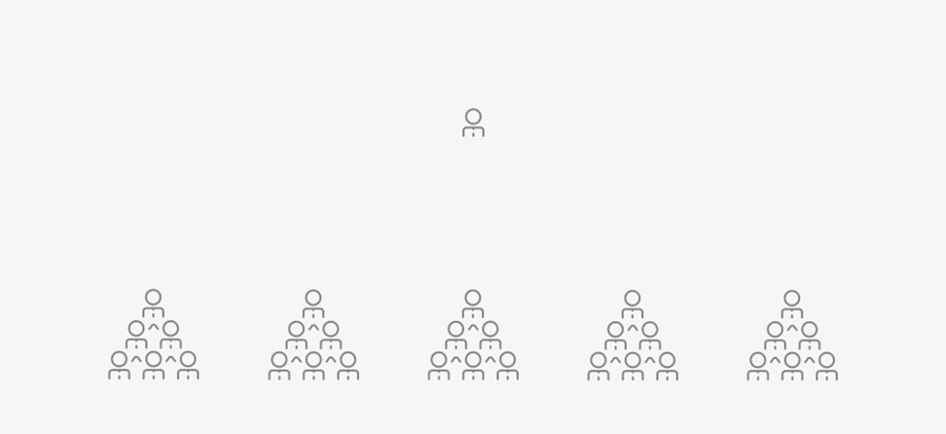
Why Do We Need Site Admins?
Server Admin – Infrastructure, Architecture, Daily Ops
Server Users

Slide 69
Why Do We Need Site Admins?
Server Admin – Infrastructure, Architecture… Daily Ops
Server Users
Server Users
Server Users
Server Users
Server Users

Slide 70
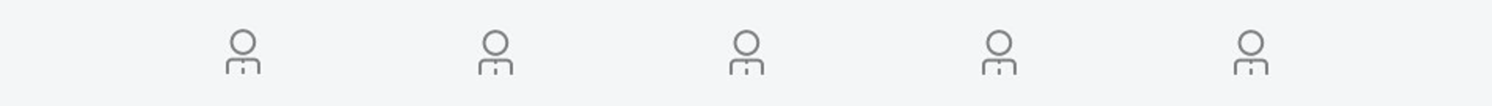
Why Do We Need Site Admins?
Server Admin – Infrastructure, Architecture
Daily Ops
Site Admin
Server Users
Server Users
Server Users
Server Users
Server Users

Slide 71
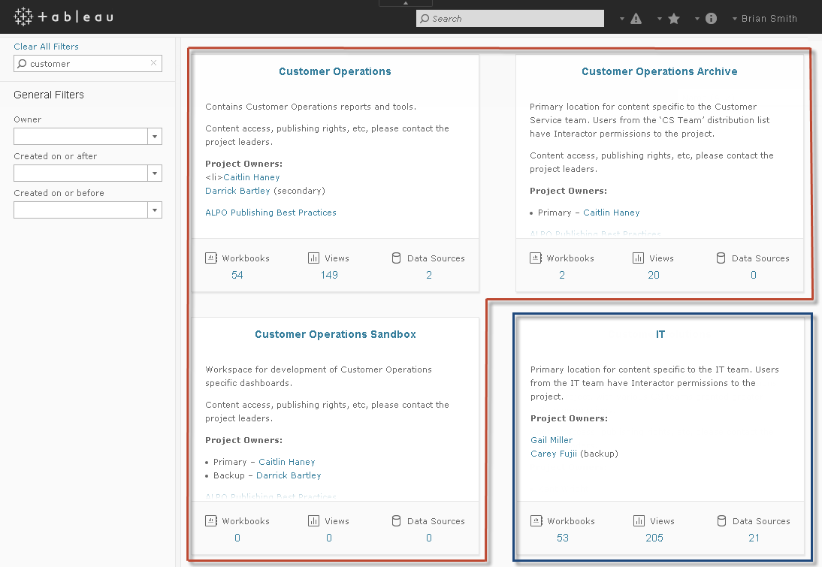
Managing Content

Slide 72
Common Roles and Responsibilities
System Admins – IT
Manage Server Configuration (how many processes run on each node in the cluster, caching settings, email settings, SSL, license keys, etc.)
Create new Schedules (for email subscriptions and extract refreshes)
Create Sites to separate workspaces for different BU’s (and optionally assign user & storage quotas for each BU)
Site Admins – Bus
Add users to their Site (either by importing AD groups, from csv, or manually)
Create Projects to manage permissions
Move content from QA projects to Production projects
Connection Builders – IT & Bus (depending on data source)
Create new data connections and publish to server
Make changes to data connections (add hierarchy, change calculation, etc.) and republish
Report Builders – Bus
Create new workbooks based on published data connections
Handle ad-hoc requests as well as build standard dashboards to be published and shared with server users
Use Data Blending to combine multiple sources into a single visualization or dashboard (*requires knowledge of how sources should be linked)
Consumers – Bus
View and Interact with reports and dashboards that have been published to the server
Can self-subscribe to reports and dashboards to have pictures of them emailed on a schedule
These roles could be combined

Slide 73

What is a Site Admin?
Sits at the crossroads of Business and IT
Like a System Admin but scoped to a site for day-to-day administration
Delegates responsibilities to people closer to the users in the site
Translates into efficiency gains, competitive advantage, and higher adoption rates
By definition, manages:
Projects, Workbooks, Data Connections
Content Permissions
Groups and Users
Business
IT

Slide 74
Who is a Site Admin?
Could be Business or IT and trained to understand and actively contribute to:
Governance policies, procedures, and risk management
Ongoing education and on-demand support
Adoption and collaboration
Supports sustainable growth of self-service analytics
Notes:
Empowering and enabling rather than controlling.

Slide 75

Site Admin Responsibilities
Site Organization
Content Publishing
Groups + Users
Permissions
Utilization
Adoption
Performance
Compliance
Content
Data Strategy
Schedules
Community
MANAGE
MONITOR
MAINTAIN

Slide 76
Managing Tasks
Site Organization | Content Publishing | Groups + Users | Permissions
Projects | Naming Conventions | Group Membership | Project-Based
Workbooks | Content Promotion | User Onboarding | Effective Permissions
Data Sources | Duplicate Content | Site Roles
Groups | Descriptions
Users | Tags

Slide 77
Monitoring Tasks
Utilization | Adoption | Performance | Compliance
View Traffic | User Engagement | Slow Dashboards | Security
Project Traffic | Content Creation | Large Workbooks | Data Connections
Content Owners | Audience | Long Extract Refreshes | Regulatory Policies
Cyclical Trends | Subscribers | Subscription Delivery | Visual Standard

Slide 78
Maintaining Tasks
Content | Data Strategy | Schedule | Community
Reassign Ownership | Successful Refreshes | Extract Timing | Ongoing Education
Stale Content | Embedded vs Published | Subscription Timing | System Admins
Low-Traffic Content | Data Quality |  | Site Admins
 | Data Standard |  | Desktop Champions
 |  |  | Users

Slide 79
Keys to Success
Use Admin Views and subscribe to them
Server Admins extract, create Published Data Sources, schedule refresh <installdir>\Tableau\Tableau Server\9.1\wgserver\z5\WEB-INF\admin\tabbed_admin_views.twb
Build custom admin views from Published Data Sources to measure actual against goals
Create an Admin site or project with the default and custom admin views and Published Data Sources
Draft and publish current documentation on enablement intranet
Policies + procedures, IT/User workflows, Best Practices
Establish task/frequency expectation
Meet regularly with Server Admin, other Site Admins, and Desktop Champions
Platform performance, utilization and adoption, user onboarding events
Hold Site Admins accountable for site health and achieve better governance results

Slide 80
How does it all fit together?
CENTER OF OPERATIONS
CENTER OF EXPERTISE
PLATFORM
PROCESS
STRATEGY
IT shifts from doer to enabler
Consider the foundations of Tableau Drive
People
Process
Platform
Site Admins focus on Process
Governance
Best Practices
Community
Equip Site Admins with tools they need to make data-driven decisions
EDUCATION
+ SUPPORT
RESOURCES
PEOPLE
COMMUNITY
DATA
ACCESS
VISUAL
ANALYTICS
BEST
PRACTICES
DATA
QUALITY
GOVERNANCE
+ SECURITY
INFRASTRUCTURE

Slide 81
